Slide 1
MACHINE LEARNING • FINAL REVIEW
Product Demand Forecasting
Using Ridge and Lasso Regression
Batch 29
Name: KAIRAV VASHI
Roll No.: 2520030582
Section: 8
Guide: Mr. Asif Shaik
(Assistant Professor, Department of CSE)
A.Y. 2026-27

Slide 2

Problem Statement
Predict a product's order demand on a given day using historical demand data, warehouse, product category, promotions, holidays, and petrol price — so retailers can plan inventory and procurement more accurately.
Project Scope
Type: Supervised Regression
Target: Order_Demand (continuous)
Models: Ridge Regression, Lasso Regression
Evaluation: RMSE, MAE, MAPE, R²
Outcome: A model + coefficient analysis retailers can use for inventory planning
Why Ridge & Lasso?
One-hot encoding Warehouse and Product_Category (30+ categories) creates many correlated features — a classic multicollinearity scenario.
Plain linear regression overfits under these conditions; L2 (Ridge) and L1 (Lasso) regularization directly address this.
Lasso additionally performs automatic feature selection — useful with 30+ engineered category columns.
Product Demand Forecasting — Review 2
2

Slide 3
Dataset Overview
Retail_Dataset.csv — historical daily product order demand, sourced from Kaggle
169,211
4
30
2,117
Records
Warehouses
Product Categories
Unique Products
Feature Columns
Product_Code / Product_id Product identifiers
Warehouse 4 categories (A, C, J, S)
Product_Category 30 categories
Date Daily records
Order_Demand Target variable
Open, Promo Store status & promotion flags
StateHoliday, SchoolHoliday Holiday indicators
Petrol_price Daily fuel price index
Product Demand Forecasting — Review 2
3

Slide 4





Data Cleaning & Preprocessing
Missing Values & Duplicates
Date Parsing
Outlier Treatment
Checked explicitly — none found in either full-row duplicates or duplicate (Product, Date) pairs.
Parsed as M/D/YYYY; extracted Year, Month, Day, and DayOfWeek as separate numeric features.
Order_Demand capped at the 99th percentile so that extreme bulk orders no longer dominate the loss function.
Categorical Encoding
Feature Scaling
One-hot encoded Warehouse, StateHoliday, and Product_Category.
Petrol_price standardized using StandardScaler. Important since Ridge/Lasso penalize coefficient magnitude.
Product Demand Forecasting — Review 2
4

Slide 5
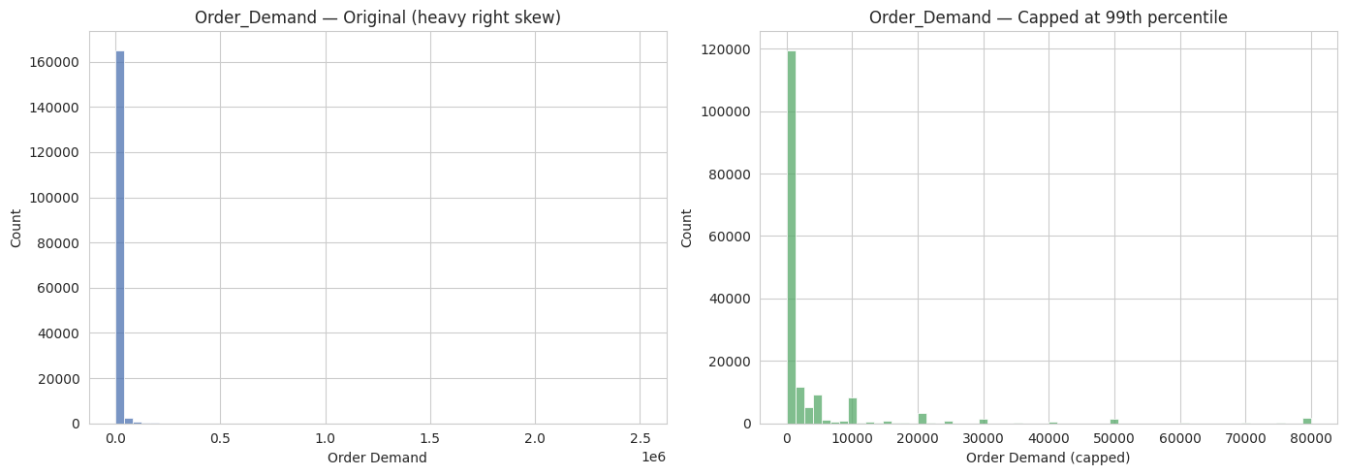
EDA — Demand Distribution
Key Observation
Order_Demand is extremely right-skewed — most orders are small, but rare bulk orders reach 2.5M units.
Left untreated, these extreme values would dominate the regression loss and distort model coefficients.
Capping at the 99th percentile (right chart) produces a distribution the model can actually learn from.
Product Demand Forecasting — Review 2
5

Slide 6
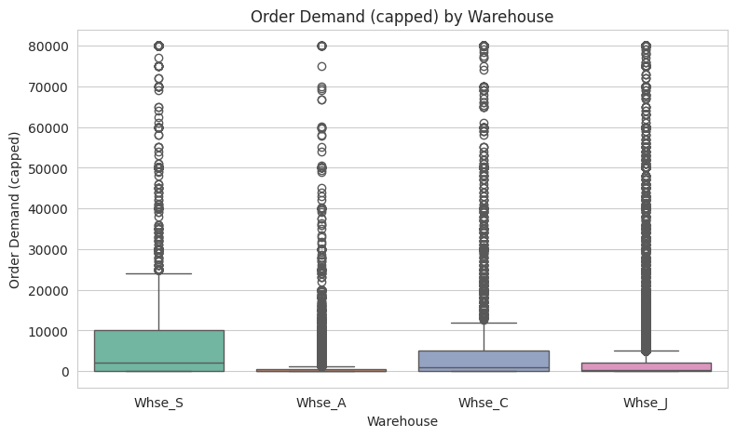

EDA — Demand by Warehouse
Key Observation
Demand varies noticeably across warehouses — Whse_S and Whse_C show higher median demand than Whse_A.
Product Demand Forecasting — Review 2
6

Slide 7
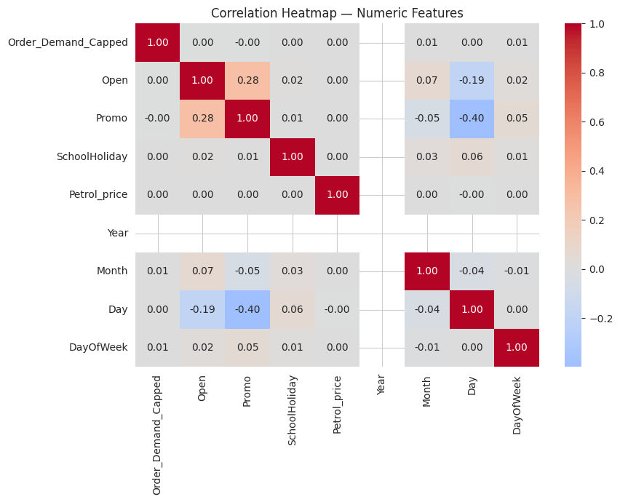
EDA — Feature Correlation
Key Observation
Weak linear correlation between individual numeric features and demand which means categorical features (Warehouse, Category) likely carry more weight.
No strong multicollinearity among these raw numeric features.
Product Demand Forecasting — Review 2
7

Slide 8
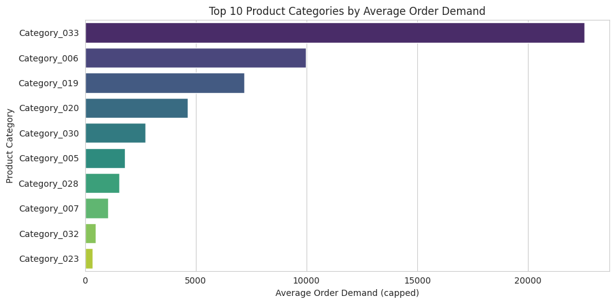
EDA — Demand by Product Category
Key Observation
Category_033 dominates average demand — more than double the next highest category.
A steep drop-off after the top 3 categories suggests category-level effects are highly uneven, not gradual.
Reinforces Product_Category as a key feature, and hints Lasso may zero out several low-impact category dummies.
Product Demand Forecasting — Review 2
8

Slide 9
Feature Engineering & Train/Test Split
Drop Product_id
70/15/15 Split
Engineer New Features
169,211 unique values across 169,211 rows — a per-row ID, not a stable product identifier. Carries no signal, so it's dropped.
Records split into train (~118K), validation (~25K), and test (~25K) sets before any target encoding or scaling is fit.
Added Is_Weekend (from DayOfWeek) and Promo_Or_Holiday, a combined promotion/holiday flag — both motivated by the EDA.
Target-Encode Product_Code
Scale Numeric Features
2,117 products mean-encoded by average Order_Demand, fit on the training set only so validation/test data never leaks in.
Year, Month, Day, DayOfWeek, Petrol_price, and the new target encoding — standardized together, fit on train only.
Product Demand Forecasting — Review 2
9

Slide 10

Methodology
Ridge (L2) vs Lasso (L1) Regression
Ridge Regression (L2)
Lasso Regression (L1)
Adds a penalty proportional to the sum of squared coefficients.
Shrinks coefficients toward zero but rarely to exactly zero — keeps all features.
Best when most features contribute at least a little to the outcome.
Handles multicollinearity by distributing weight across correlated features.
Adds a penalty proportional to the sum of absolute coefficient values.
Can shrink less useful coefficients exactly to zero — performs automatic feature selection.
Best when only a subset of features (e.g. a few dominant categories) truly matter.
Improves interpretability with 30+ one-hot encoded category columns.
Product Demand Forecasting — Review 2
10

Slide 11
Model Training & Tuning
5-fold cross-validation over a log-spaced alpha grid, using RidgeCV and LassoCV
20
5
26.4
0.34
Alpha Candidates
CV Folds
Best Ridge α
Best Lasso α
Training Details
Baseline model Linear Regression (OLS), unregularized
Ridge (L2) RidgeCV, 5-fold cross-validation
Lasso (L1) LassoCV, 5-fold CV, max_iter=5000
Best Lasso alpha ≈ 0.34
Best Ridge alpha ≈ 26.4
Tooling scikit-learn RidgeCV / LassoCV
Training set size ~118,000 records (70% of data)
Product Demand Forecasting — Review 2
11

Slide 12
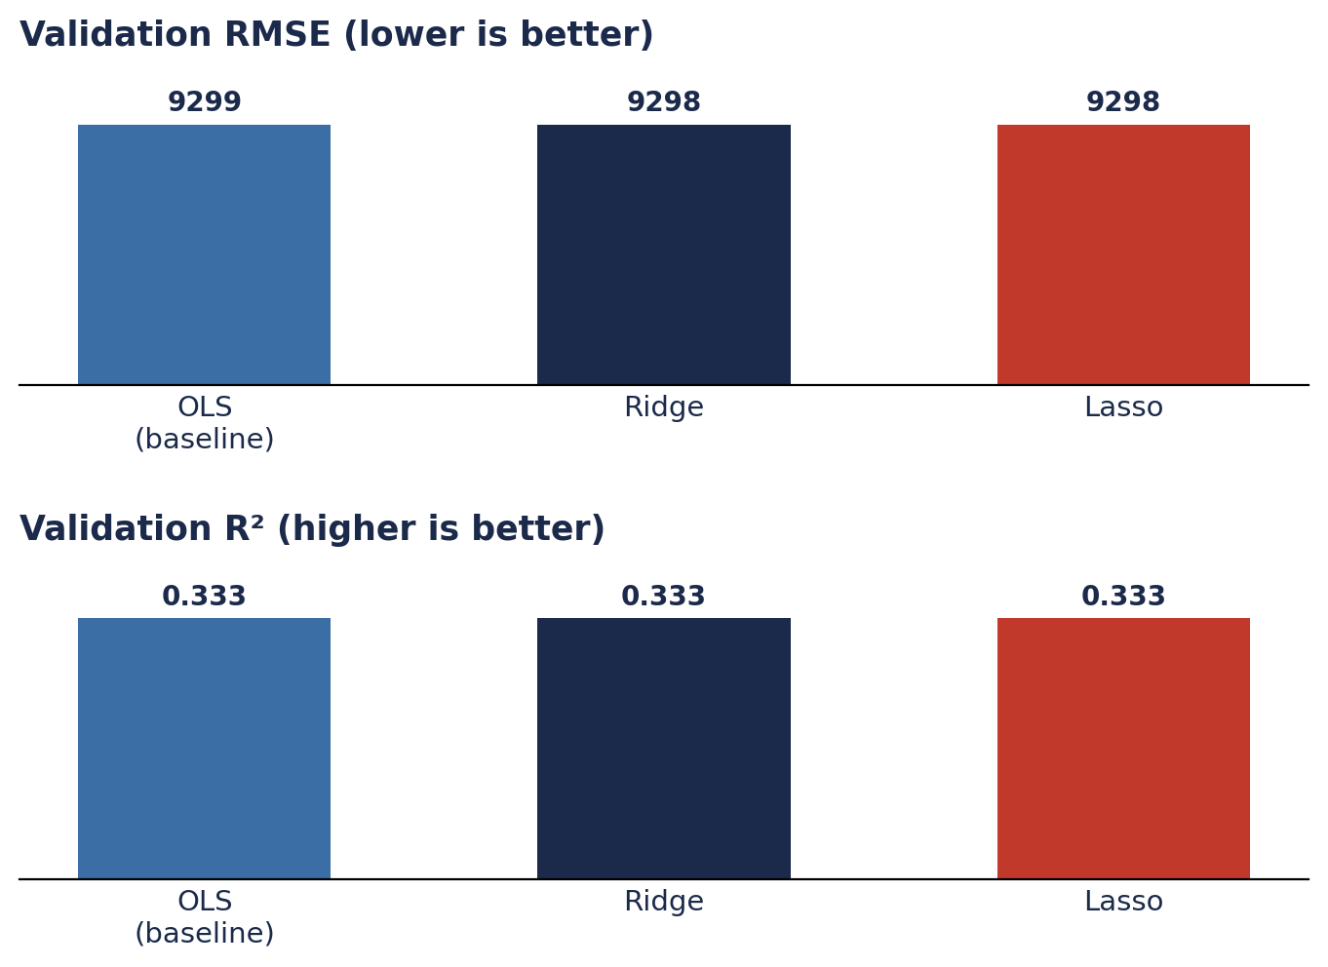
Model Evaluation
Key Observation
OLS, Ridge, and Lasso perform almost identically on validation — RMSE ≈ 9,298 and R² ≈ 0.333 for all three.
Regularization isn't fighting heavy overfitting at this dataset size — but Lasso remains the more useful model, since it also selects features.
Product Demand Forecasting — Review 2
12

Slide 13
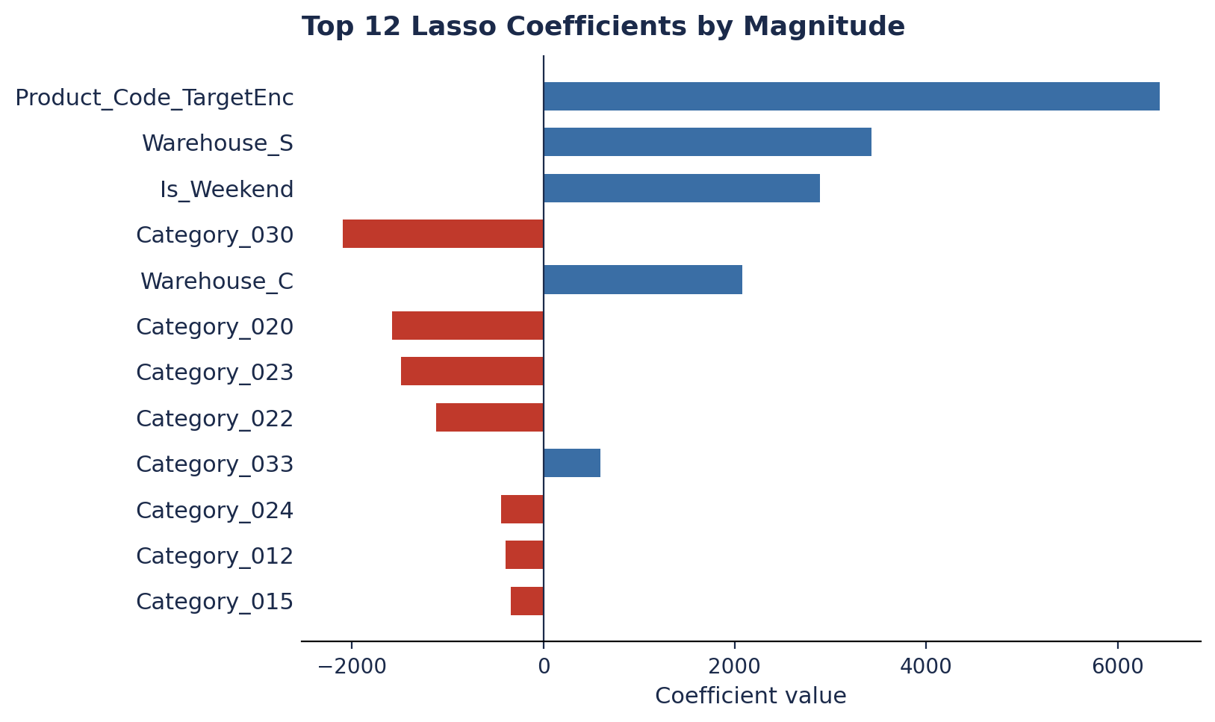
Final Model & Interpretation
Key Observation
Lasso zeroes out 14 of 45 features entirely — automatic feature selection that directly answers which factors drive demand.
Product_Code_TargetEnc dominates by a wide margin, followed by Warehouse and select Product_Category dummies — echoing the EDA.
On the untouched test set, Lasso holds at R² ≈ 0.33, confirming the validation result generalizes.
Product Demand Forecasting — Review 2
13

Slide 14
Conclusion & Key Takeaways
This project successfully predicts product order demand using Ridge and Lasso regression — delivering both a working model and clear insight into which factors actually drive demand.
Next Steps
Deployment: optional Streamlit/FastAPI wrapper around the trained Lasso model
Richer signal: lag / rolling-window demand features for short-term momentum
Non-linear models: benchmark against Random Forest / XGBoost as a stretch goal
Per-category tuning: explore whether alpha should vary by product category
Deliverables: updated notebook, EDA report, and this review deck
What We Found
OLS, Ridge, and Lasso all reach R² ≈ 0.33 on validation and test — here, regularization helps mainly through interpretability, not raw accuracy.
Lasso zeroes out 14 of 45 engineered features automatically, cleanly separating signal from noise among the one-hot category columns.
Product identity (via target encoding), Warehouse, and a handful of Product Categories are the dominant drivers of demand.
Product Demand Forecasting — Review 2
15

Slide 15

Reference Research Paper
Retail Demand Forecasting: A Comparative Study for Multivariate Time Series
Haque, Amin & Miah (2023)
Trains Lasso, Ridge, LightGBM, XGBoost, and Decision Tree on Walmart retail sales data enriched with macroeconomic variables. Compares RMSE/MAE across models. direct benchmark for this project's model choices.
Product Demand Forecasting — Review 2
14

Slide 16
THANK YOU.

